Slide 1

Customer Churn Analysis
Presented By :
Boddu Chaitanya & Mahesh Bollu
Batch No : 435
Innomatics Research Labs – Dilsukhnagar

Slide 2
Agenda :
Business Problem Statement
Objective
Problem Statement
Dataset Overview
Raw Dataset
Data Preparation
Dashboard Visualizations
Key Insights & Findings
Applications & Recommendation
Conclusion

Slide 3
BUSINESS PROBLEM STATEMENT
The organization is facing a significant customer churn problem, where a large number of customers discontinue services and switch to competitors. This directly results in revenue loss, reduced customer lifetime value, and increased costs of acquiring new customers.
Due to the lack of clear, data-driven insights, the organization is unable to identify the key reasons behind customer churn or detect high-risk customers in advance. As a result, management struggles to take timely and targeted actions to retain customers.
To address this challenge, the business requires a data-driven analytical solution that can identify churn drivers, highlight high-risk customer segments, and quantify the business impact of churn, enabling informed decision-making and effective customer retention strategies.

Slide 4
PROBLEM STATEMENT
The telecom company is facing a high rate of customer churn, where customers discontinue services and move to competitors. Customer churn leads to loss of revenue, reduced customer lifetime value, and impacts long-term business growth. The organization lacks clear visibility into the reasons behind customer churn. It is difficult to identify high-risk customers early using raw data alone. Customer behavior varies based on contract type, tenure, service usage, and billing patterns. Factors such as high monthly charges, short-term contracts, limited services, and lack of customer support may influence churn.
Existing data is not effectively transformed into actionable insights for decision-makers. There is a need for a data-driven analytical solution to study churn patterns. Interactive dashboards are required to explore churn across customer segments. The analysis should support better decision-making and help design customer retention strategies.

Slide 5
OBJECTIVE
Analyze customer data to understand churn patterns and behavior.
Identify key factors influencing churn such as contract type, tenure, and charges.
Detect high-risk customers early using data-driven insights.
Measure the business impact of churn on revenue and customer value.
Provide interactive dashboards to support better management decisions.
Help the organization reduce churn and improve customer retention.
Enable targeted retention strategies by identifying the most vulnerable customer segments.
Support cost-effective decision-making by focusing retention efforts on high-value customers.

Slide 6
Dataset Overview :
This project is based on a telecom customer churn dataset collected from a service provider for analytical purposes. It contains 7,043 customer records and 21 columns of information.
Dataset includes:
  Demographic details: Gender, Senior Citizen, Partner, Dependents
  Account details: Tenure, Contract Type, Payment Method, Paperless Billing
  Services subscribed: Internet Service, Phone Service, Streaming TV, Tech Support, Security
  Billing information: Monthly Charges, Total Charges
  Target column: Churn (Yes/No)

Slide 7
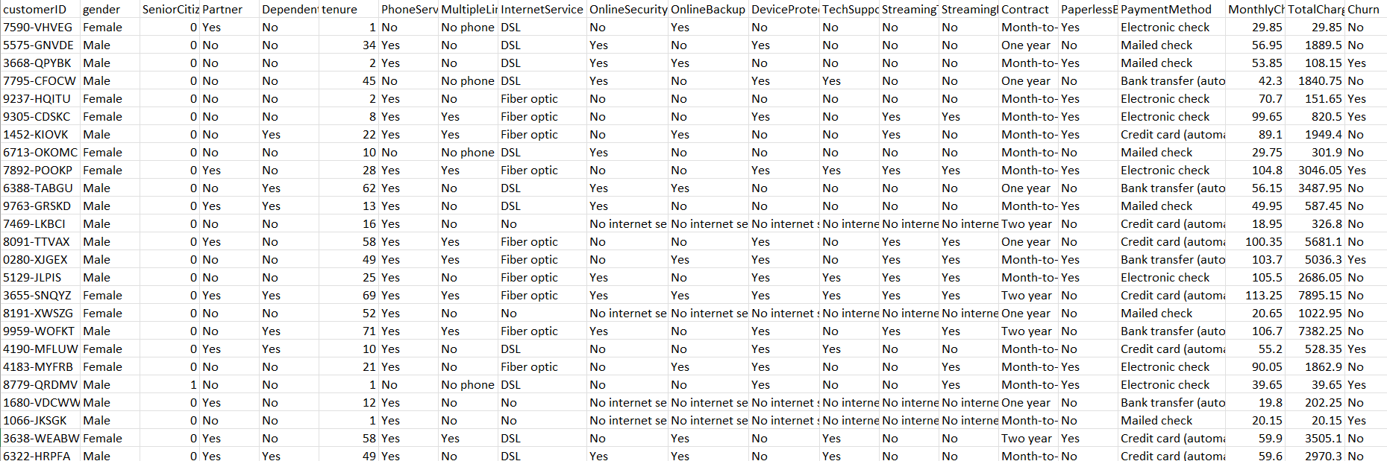
Raw Dataset :

Slide 8
Data Preparation :
Removed blank customer records created due to missing tenure or billing information during import.
Converted tenure column to whole number format to support grouping and aggregation.
Verified Monthly Charges and Total Charges contain only valid numeric values after type conversion.
Ensured one row per customer by validating customer-level granularity (no duplicate customer entries).
Validated and standardized contract categories to eliminate inconsistencies and ensure accurate comparison of churn behavior across contract types.
  Month-to-month
  One year
  Two year
Validated Payment Method categories to ensure no spelling or case mismatches affecting visuals.
Reviewed churn column to confirm it contains only Yes / No values with no nulls.

Slide 9
Tenure-Based Customer Classification
Original Tenure column had values like: 1, 5, 13, 45 months, which were hard to analyze as continuous numbers.
Customers were segmented into lifecycle-based Tenure buckets by creating a derived tenure classification column, enabling comparative churn analysis across different customer maturity stages.
  0–12 months
  12–24 months
  24–48 months
  48–72 months
These groups help identify which customer segments have the highest churn rates.
Final dataset was validated for filter, slicer, and DAX compatibility before report creation.

Slide 10
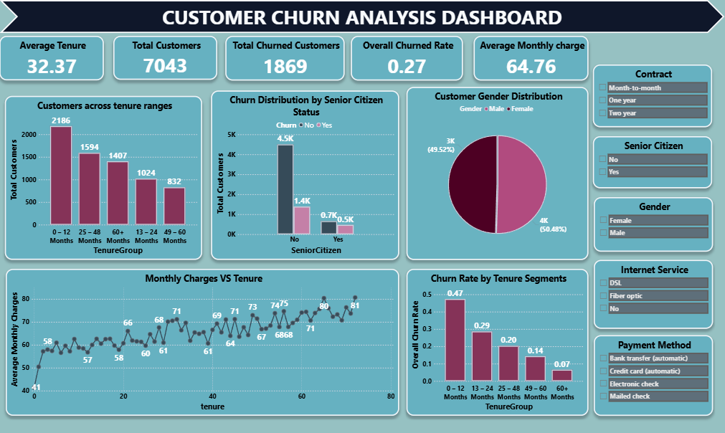

Slide 11
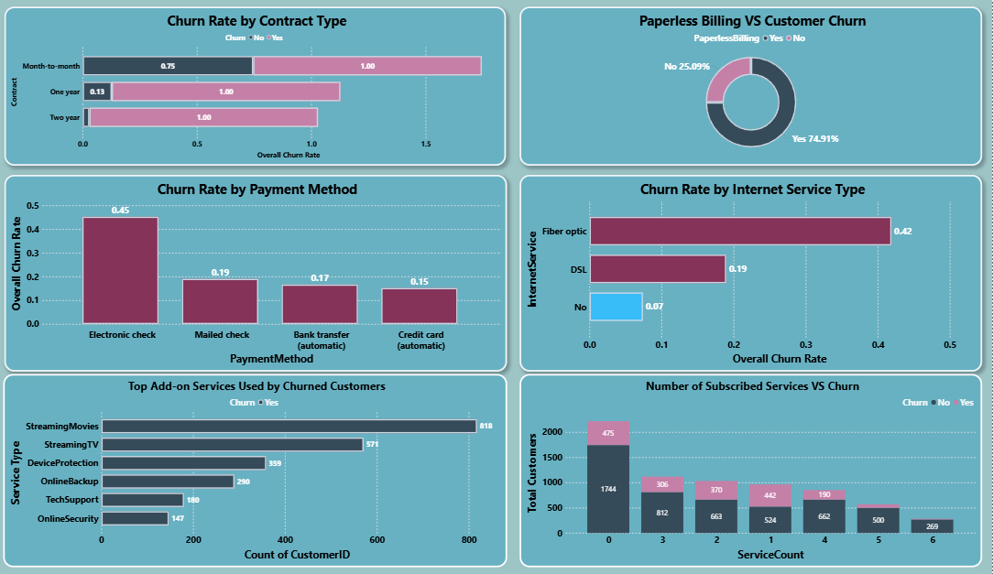

Slide 12
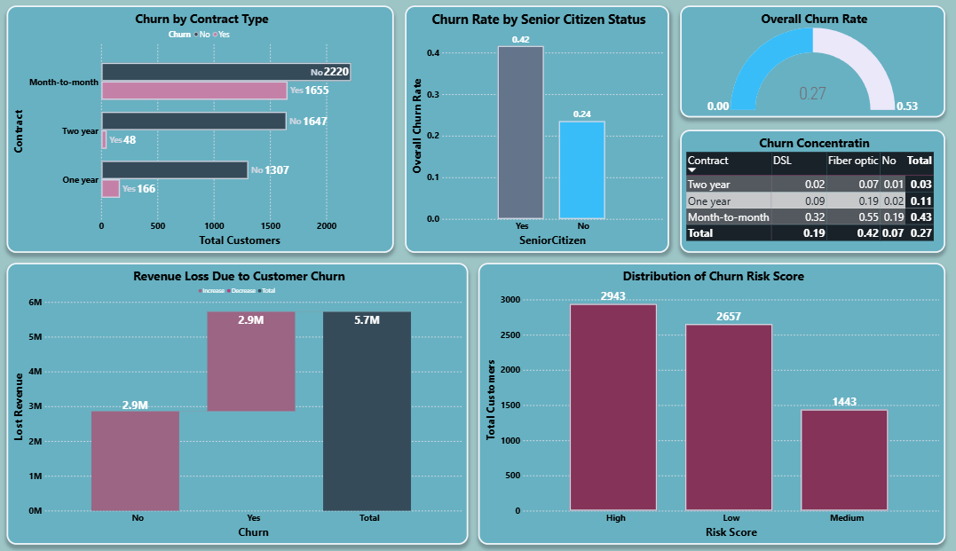

Slide 13
Key Insights & Findings :
High churn is concentrated among month-to-month contract customers, indicating lack of long-term commitment as a major churn driver.
Customers with higher monthly charges show a significantly higher churn rate, especially those using Fiber Optic internet services.
Short-tenure customers are the most likely to churn, highlighting the importance of early-stage customer engagement and onboarding.
Lack of add-on services (Online Security, Tech Support, Backup) is strongly associated with higher churn, suggesting value-added services improve retention.
Paperless billing and certain payment methods correlate with higher churn, indicating billing preferences can act as churn risk indicators.

Slide 14
Applications & Recommendations
Applications:
Identify customers who are likely to leave at an early stage and take timely retention actions.
Design targeted offers and campaigns based on customer usage patterns and preferences.
Minimize revenue loss by prioritizing high-risk and high-value customers.
Recommendations:
Encourage customers to switch to long-term plans by offering discounts or incentives.
Improve onboarding, support, and guidance for new customers to enhance satisfaction.
Provide value-added services such as security, backup, or support to strengthen customer loyalty.

Slide 15
Conclusion
This project successfully analyzed customer data to understand why customers leave and why they stay. By studying customer details, services used, contract types, and billing information, key patterns related to churn were identified. The analysis showed that customers with short tenure, month-to-month contracts, higher monthly charges, and fewer services are more likely to churn.
Interactive Power BI dashboards made it easy to explore trends and identify high-risk customer groups. Overall, the project demonstrates how data-driven analysis can help businesses take early action, improve customer satisfaction, and reduce customer churn while protecting revenue.

Slide 16
Q & A

Slide 17

THANK YOU

